Slide 1
Introduction to the Waste Impact Calculator
Notes:
In this presentation I’m going to give you an introduction to the Waste Impact Calculator project from the Oregon Department of Environmental Quality.

Slide 2
Outline
What it is
Why we need it
Who it’s for
How it works
How to use it
What it leaves out
Alternatives
Notes:
I’m going to tell you what the Waste Impact Calculator is, why we need it, who it’s for, how it works, and how to use it.
I’m

Slide 3
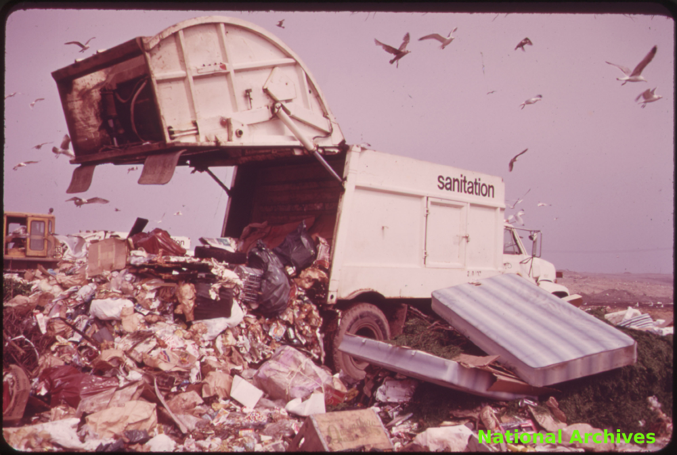
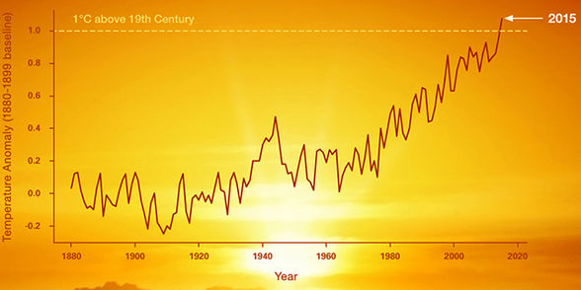
What it is
Notes:
The waste impact calculator is a tool that responds to a shift in perspective.
We know about solid waste in really traditional terms.
But we want to know about its affect on the world in very modern terms. Life cycle impacts. Like GHGs. I’ll explain more what I mean by that term in a little bit.

Slide 4
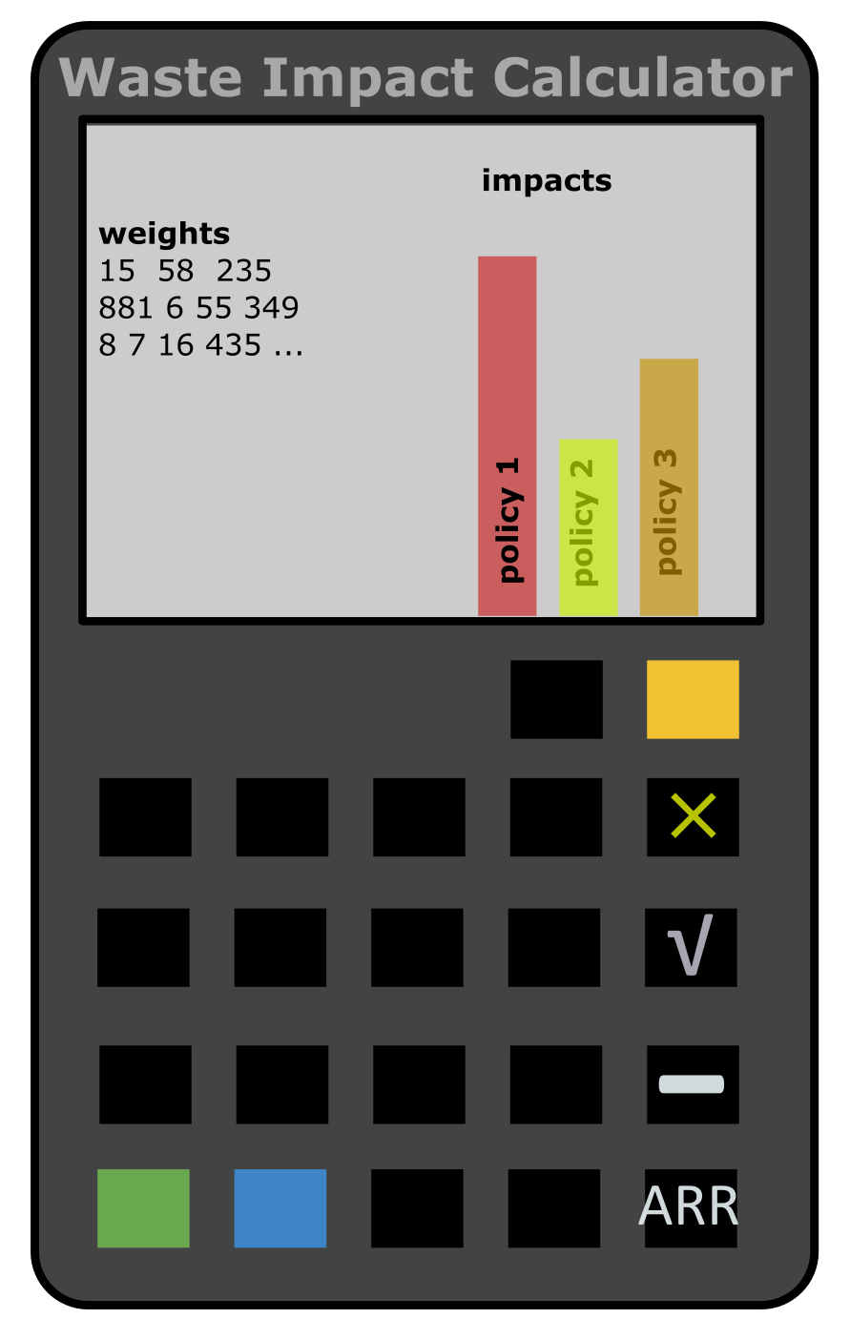
Notes:
It is a calculator. WIC takes what you know about solid waste – how many tons of stuff are going to what sorts of places – and figures the life cycle environmental impacts for that stuff. It also lets you imagine you are handling waste in different ways…. And see how the impacts change. Like maybe you would

Slide 5
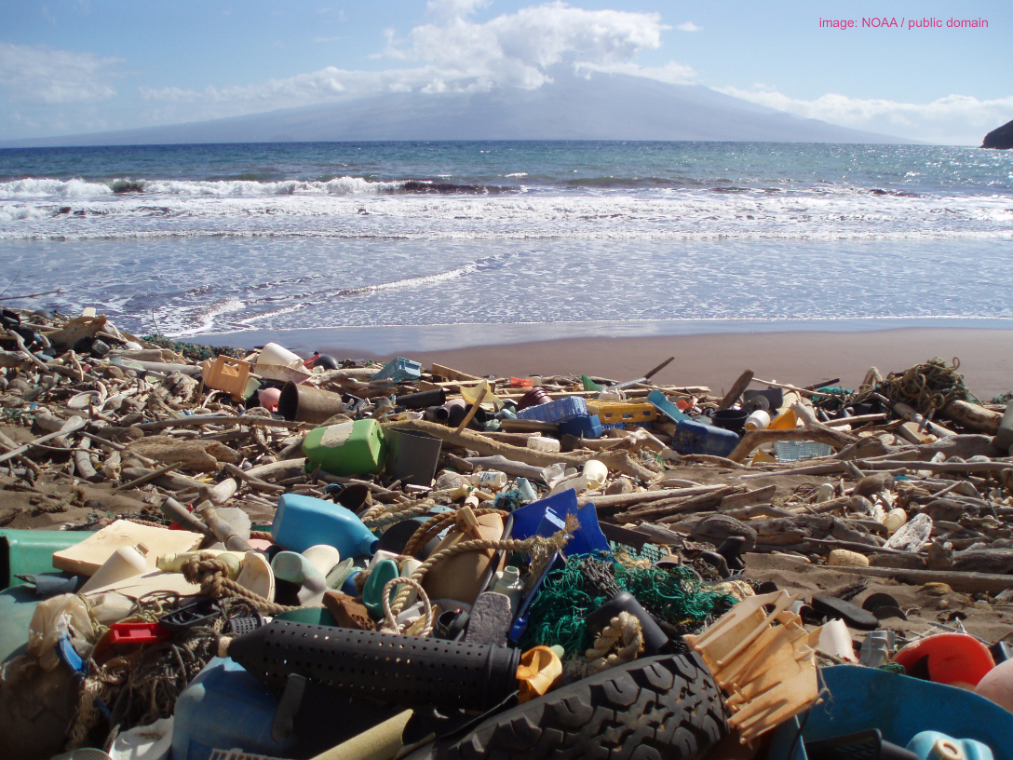
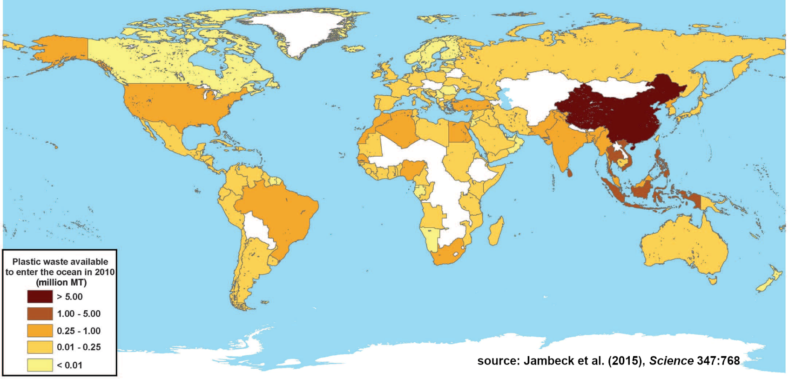
One problem with waste WIC doesn’t address
Notes:
We all feel like trash is a problem.
Recently, concern has been about the effects of litter in the environment, like this plastic trash on a Hawaiian beach. Trash like this stays around in the environment and definitely affects wildlife, as we’ve seen in a bunch of heartbreaking pictures.
To solve this problem – of trash being in the wrong places – you would want trash to be handled correctly.
However, by and large the United States is not a big source of such marine plastics. Here’s a map from a review in 2015 which suggests the biggest sources of plastic going into the ocean are Asian countries where there is not fully developed waste handling infrastructure.
For better or worse, Waste Impact Calculator does not

Slide 6
The problem it does address
Notes:
But there’s another issue. Even if all that stuff was handled perfectly, that waste still came from somewhere. I.e. before it was thrown away (animate backwards through materials life cycle)

Slide 7
Why we need it
Notes:
We need to know the total effect of all this stuff. Not just the impacts that happen at the end of life.

Slide 8
Who it’s for

Slide 9
How it works

Slide 10
How to use it

Slide 11
What it leaves out

Slide 13
Waste Impact Calculator:
Context and Concepts
Notes:
Hi, I’m Martin Brown from the Oregon Dept. of Environmental Quality, and in this presentation I’m going to give some background for the Waste Impact Calculator model.
Since you work in the field this may be old hat to you, but let me go over it anyway.

Slide 14
What is solid waste?
Notes:
The Waste Impact Calculator is about the environmental effects of solid waste. So we should define what that term “solid waste” means.

Slide 15
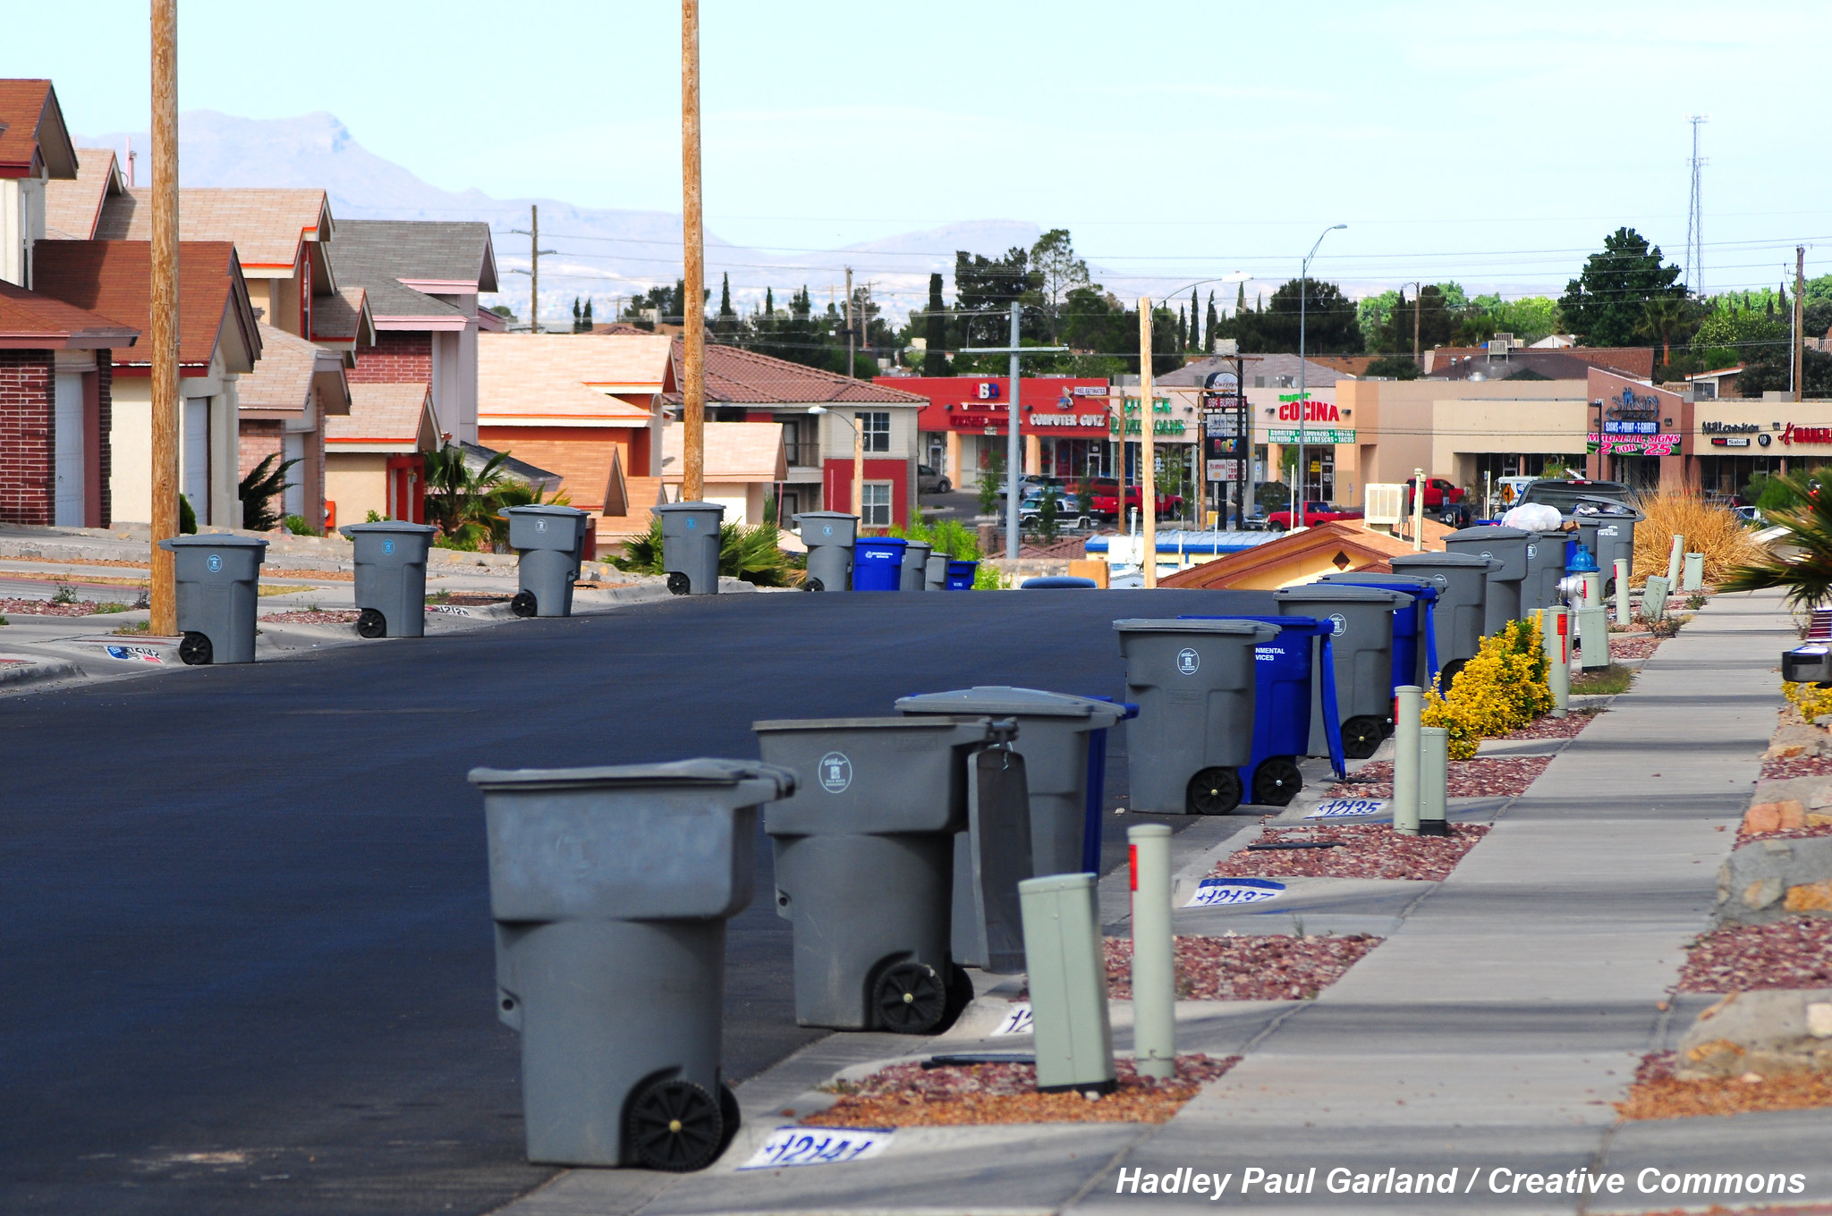
Notes:
Let’s start with an intuitive definition.
Here’s a picture of a municipal trash collection. Notice how the cans of trash and recycling are all clearly separated from the houses? Waste can be defined as the stuff that people get rid of!
That’s the viewpoint of historian Susan Strasser, in her book Waste and Want, and it’s really profound if you dwell on it.

Slide 16
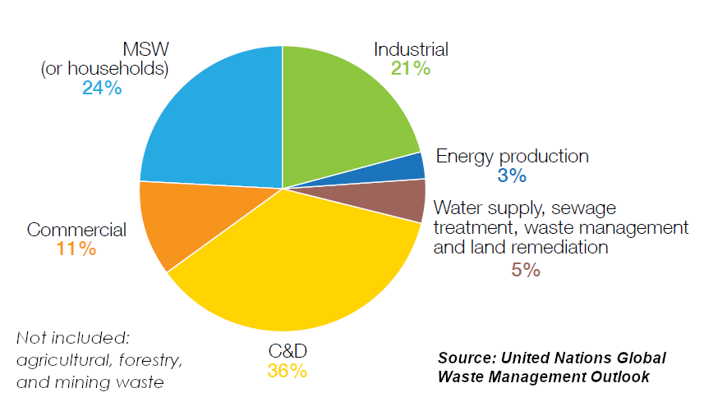
✓
?
?
✓
?
x
?
Notes:
More legalistic definitions of solid waste can be found in statistics from governments and nonprofits. Here’s a chart from the UN that attempts to break down all the different parties or activities that might have stuff to get rid of – that is, who might produce solid waste.
There are commercial operations, like stores, and households. Government statistics usually do include those in what they call solid waste, so I’ll put check marks by those operations.
But all sorts of other operations also have to get rid of stuff. Such as industrial operations, energy production facilities, water treatment plants, and construction sites. Governments differ greatly in whether they include these things in what they call solid waste.
And nobody includes the huge amounts of waste that are generated in agricultural, forestry, and mining operations.

Slide 17
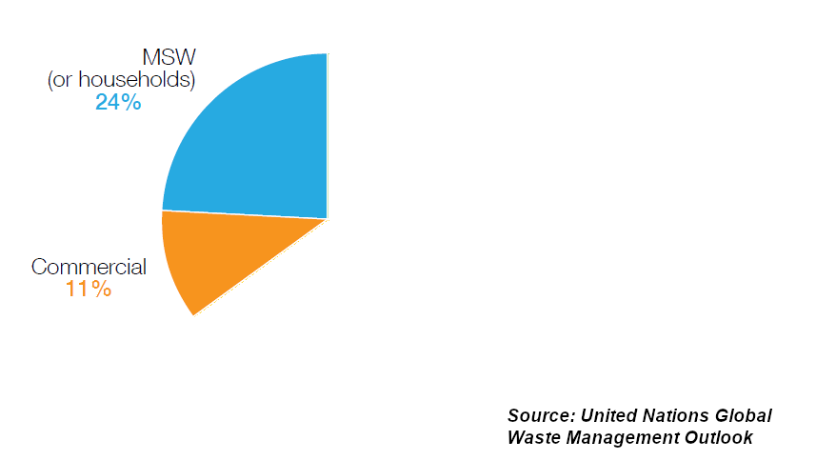
Notes:
That means when you hear the term solid waste, you are usually just hearing about municipal and commercial waste. That’s how the term is used in the Waste Impact Calculator, because that’s how Oregon defines it in its state environmental law.

Slide 18
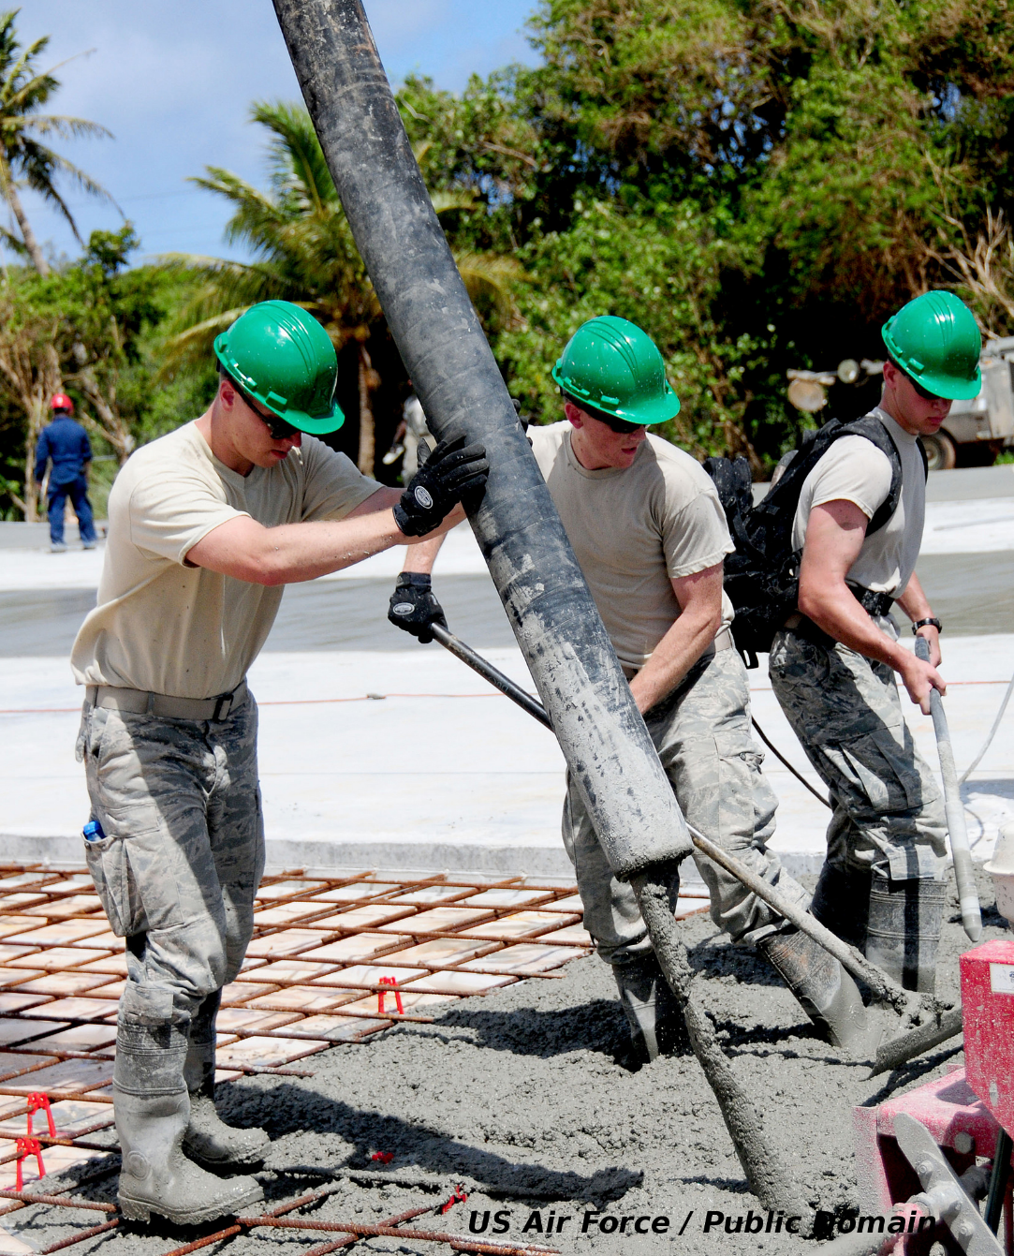
Notes:
As you get more and more into the environmental effects of solid waste, it’s important to remember that there are lots of materials which have a big impact on the environment that solid waste statistics will never tell you about.
Concrete is one example. It’s responsible for a large portion of greenhouse gas emissions planet wide, but the concrete they pour today won’t be in the solid waste stream – if it’s even counted – for a hundred years.
So solid waste is surely related to affluence and consumption, but solid waste doesn’t tell the whole story about how materials and products influence the environment.

Slide 19
How is solid waste a problem?
Two views, each with inherent goals and statistics
Notes:
Solid waste is usually presented as a source of problems. Let’s get specific about how solid waste can, or just might, be a bad thing and how that tends to be measured.

Slide 20
The traditional view: direct effects of waste and litter
Notes:
The traditional way of describing the problem of solid waste has been to describe the direct physical effects it does, or could, have.

Slide 21
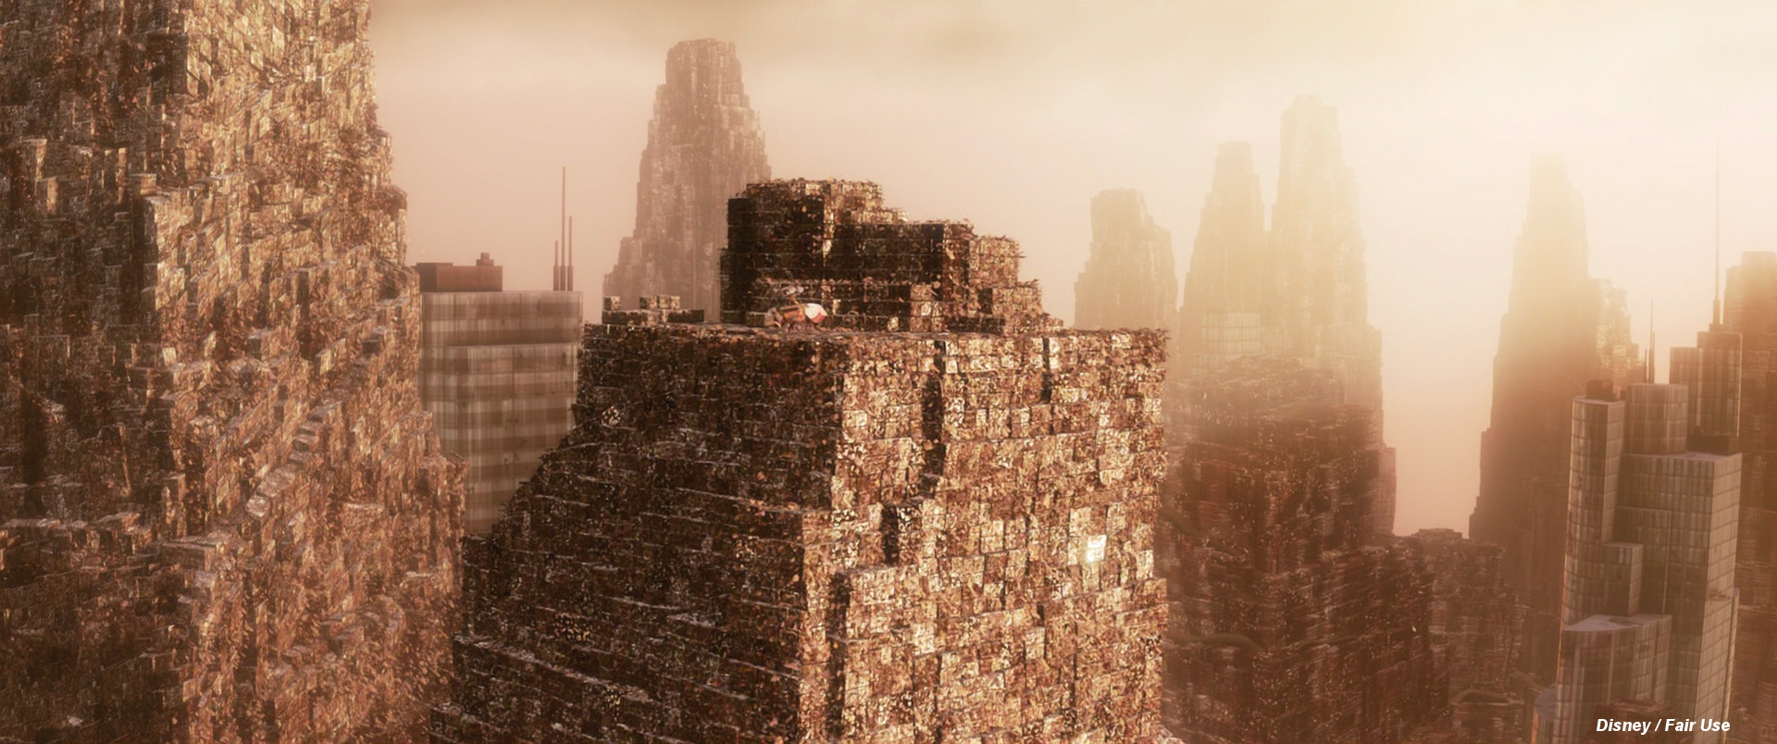
Notes:
First, there used to be a concern that the country or the world was literally running out of room to put waste. You’ve probably seen this amazing scene in WALL-E where our hero builds a ziggurat out of compacted trash.
It certainly is poetic, but as a practical matter there are many places where this is not true. Disposing of stuff might not be a good idea, but, at least in the American west, there’s lots of room to do it.

Slide 22

Notes:
More recently, concern has been about the effects of litter in the environment, like this plastic trash on a Hawaiian beach. Trash like this stays around in the environment and definitely affects wildlife, as we’ve seen in a bunch of heartbreaking pictures.

Slide 23

Notes:
However, by and large the United States is not a big source of such marine plastics. Here’s a map from a review in 2015 which suggests the biggest sources of plastic going into the ocean are Asian countries where there is not fully developed waste handling infrastructure.

Slide 24
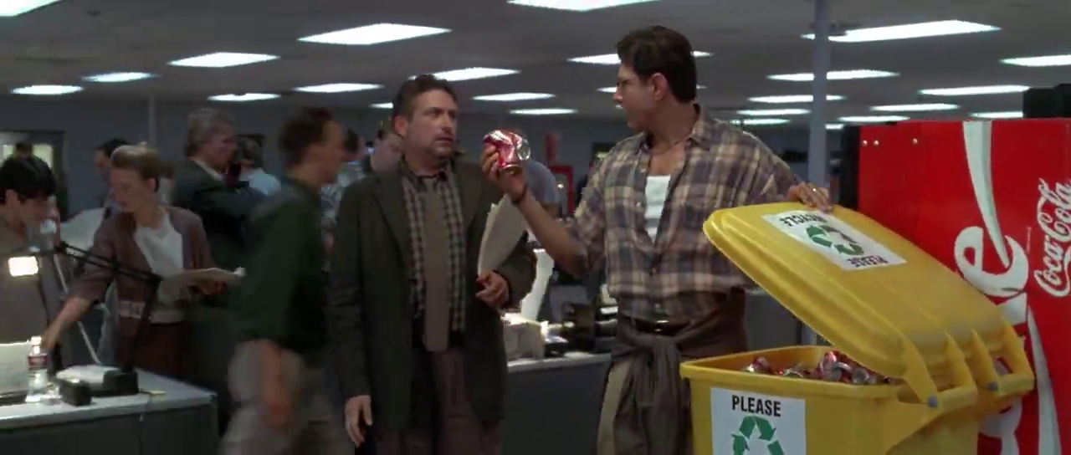
Notes:
Finally, there’s a natural conservative impulse to try to preserve the value in things. Here’s a picture from the movie independence day where the hero – who later is going to literally save the world – is encouraging his coworker to recycle.

Slide 25
Themes of the traditional view
Waste can cause problems directly – like litter
However, waste is still a resource and the value it has should be preserved
Landfilling is bad
Recycling is good
The goal of management is to prevent landfilling.
Notes:
To sum up, the traditional view of the “problem” of solid waste is that – even though waste is kind of a bad thing – it is also a resource that we are throwing away. Because it’s a resource, landfilling it is bad, and recycling it is good.

Slide 26
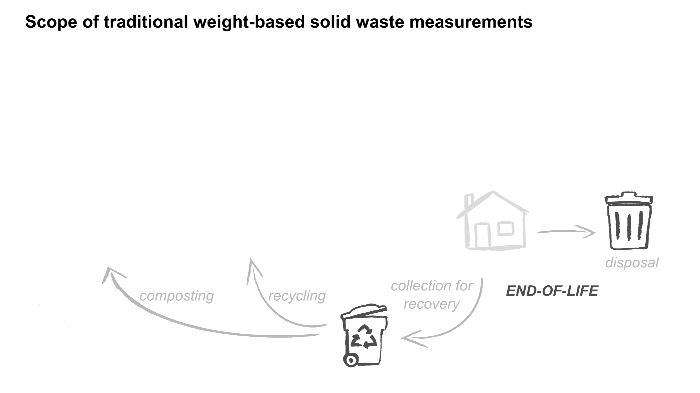
Traditional waste statistics express those themes with weights
Generation = total weight (tons)
Recycling Rate = recycling weight / total weight (%)
Notes:
The traditional ways of quantifying solid waste have reflected these themes, in particular expressing them in terms of weight.
The total amount of stuff leaving households and businesses, whether to be disposed or recycled, is called waste generation, and it’s in tons.
The percentage of that amount that you happen to recycle is the recycling rate. In Oregon we call that the recovery rate because it also includes composting.

Slide 27
A different view: indirect worldwide effects of waste
Notes:
However, there’s another way of looking at the problem of waste, which is more indirect but also very significant.

Slide 28
Observe… something is clearly missing from this chart
Everything that is waste comes from somewhere
Notes:
It comes from an observation about this diagram. When you look at it, it’s easy to see that something is missing.
Waste isn’t actually generated by households and businesses. The stuff that becomes waste had to come from somewhere….

Slide 29
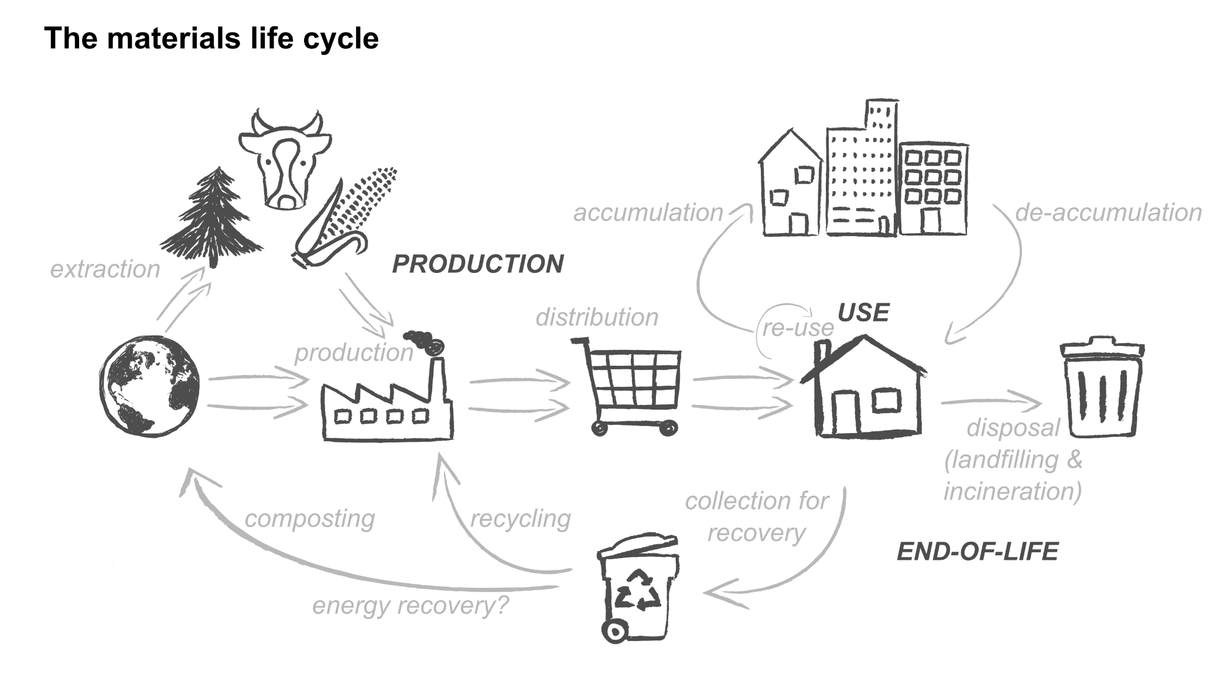
The materials life cycle
Notes:
And we call that fact the materials life cycle.
Everything that becomes waste started out by being extracted from the earth somehow. Then it was packaged or refined, made into products. Then it was distributed and used. Finally it was disposed or recycled.
But the point is there is a lot activity along the way. At every step fuel was burned, water was used, a bit of pollution was generated, and so on.

Slide 30
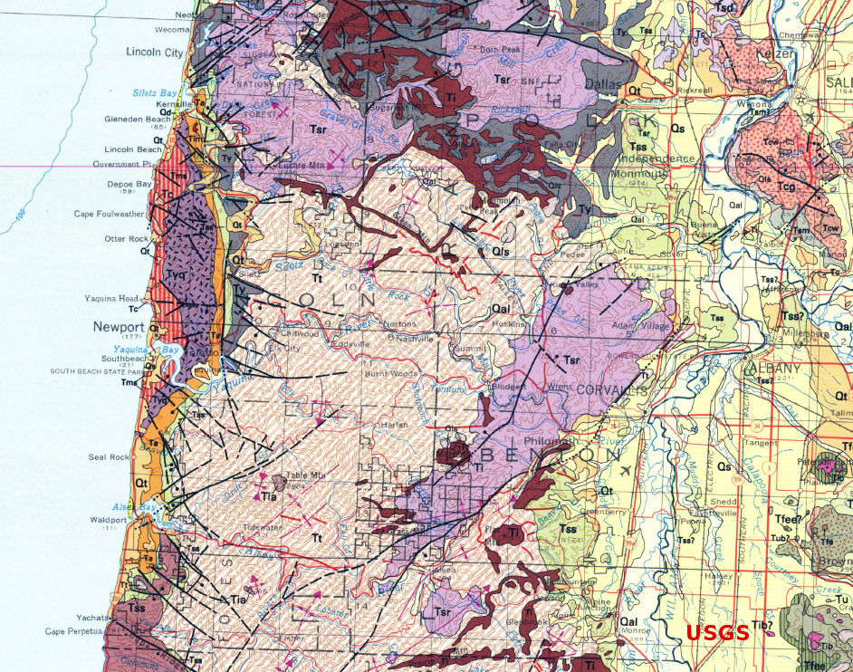
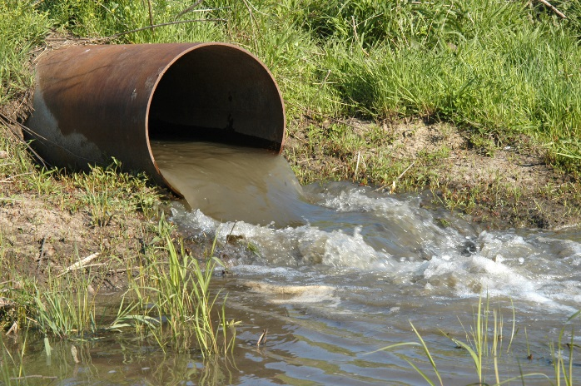
Environmental impacts happen at every step
Notes:
These are “environmental impacts” GHG emissions, water pollution, and land use change. The material in waste is linked to all those changes – not just whatever might happen in the landfill or recycling system.

Slide 31
Measurements should report the total impacts of the stuff that becomes waste
Notes:
This new view says that the effect of solid waste should be measured by the total impact linked to that waste over the whole materials life cycle.

Slide 32
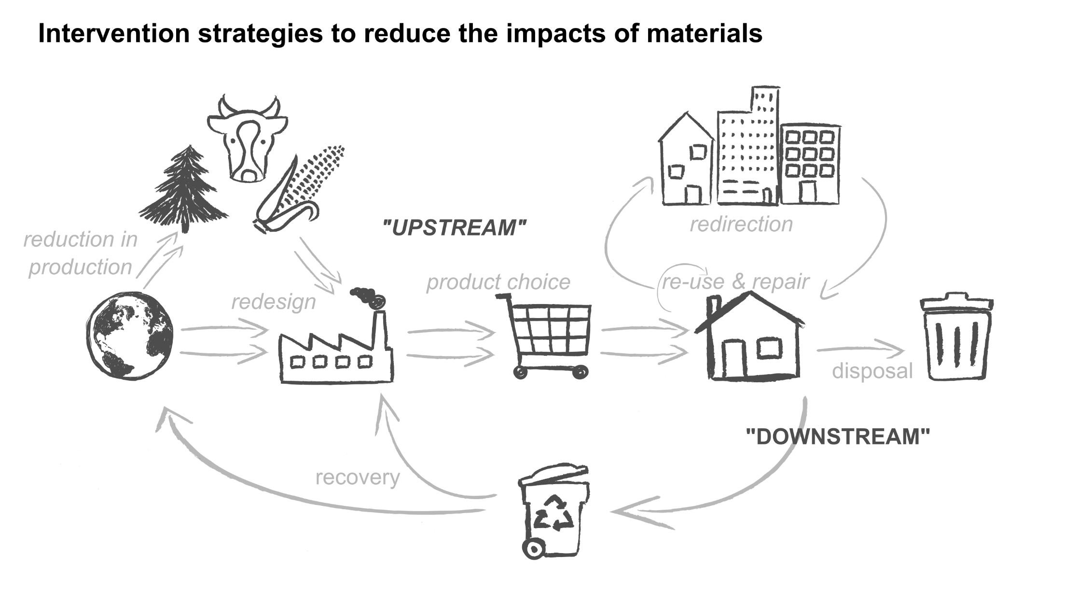
The goal of management is to minimize impacts – by any means
Notes:
There are lots of ways to reduce impacts. Products can be redesigned. They can be made to last longer. They can be produced in a different way. And yes, they can be recycled, but that’s just one way of many.

Slide 33
Themes of the life cycle impact view
Waste represents materials that have caused impacts over the course of their life cycles
The goal is to reduce the total impacts of the materials that become waste
There are many ways to do this
Because of this broader view, “waste management” might be reconceived as “materials management”

Slide 34
WIC bridges the gap

Slide 35
Notes:
It is a calculator. WIC takes what you know about solid waste – how many tons of stuff are going to what sorts of places – and figures the life cycle environmental impacts for that stuff. It also lets you imagine you are handling waste in different ways…. And see how the impacts change.

Slide 36
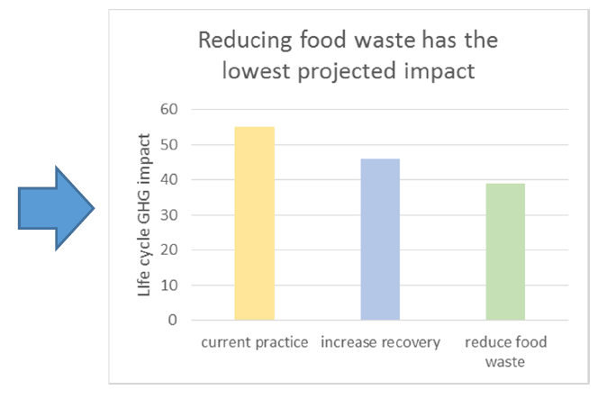
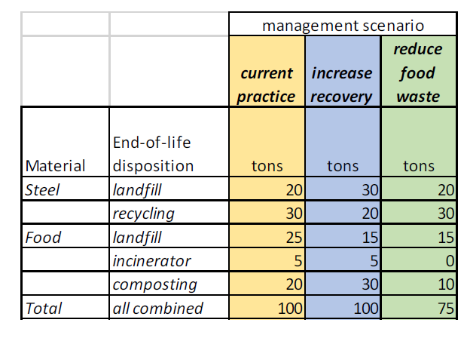
Basic operation
You have to start with solid waste data
The calculator works it backwards through the life cycle and changes it into life cycle impacts
Notes:
Basically the way it works is you have to input a description of your solid waste in terms of tons. Here’s an example, where there’s some steel and some food waste. Some of the steel is recycled, and some of the food is composted.
WIC takes these tons and works them backwards through the materials life cycle to get a total impact associated with the waste.

Slide 37
You play around with managing tons to see how to lower impacts
Notes:
However, just one total isn’t very interesting. You can put in other scenarios for dealing with waste and see if it lowers the impact. Here’s one scenario where recovery is increased. And other where food waste is just prevented.
If you look over at the chart, you see the lowest bar is for the last scenario.
In the Waste Impact Calculator, lower impacts are always better. So you are looking for the ways to make your bars smaller.

Slide 38
Let’s try it!

